Slide 1



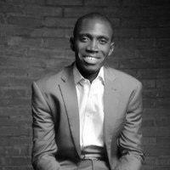
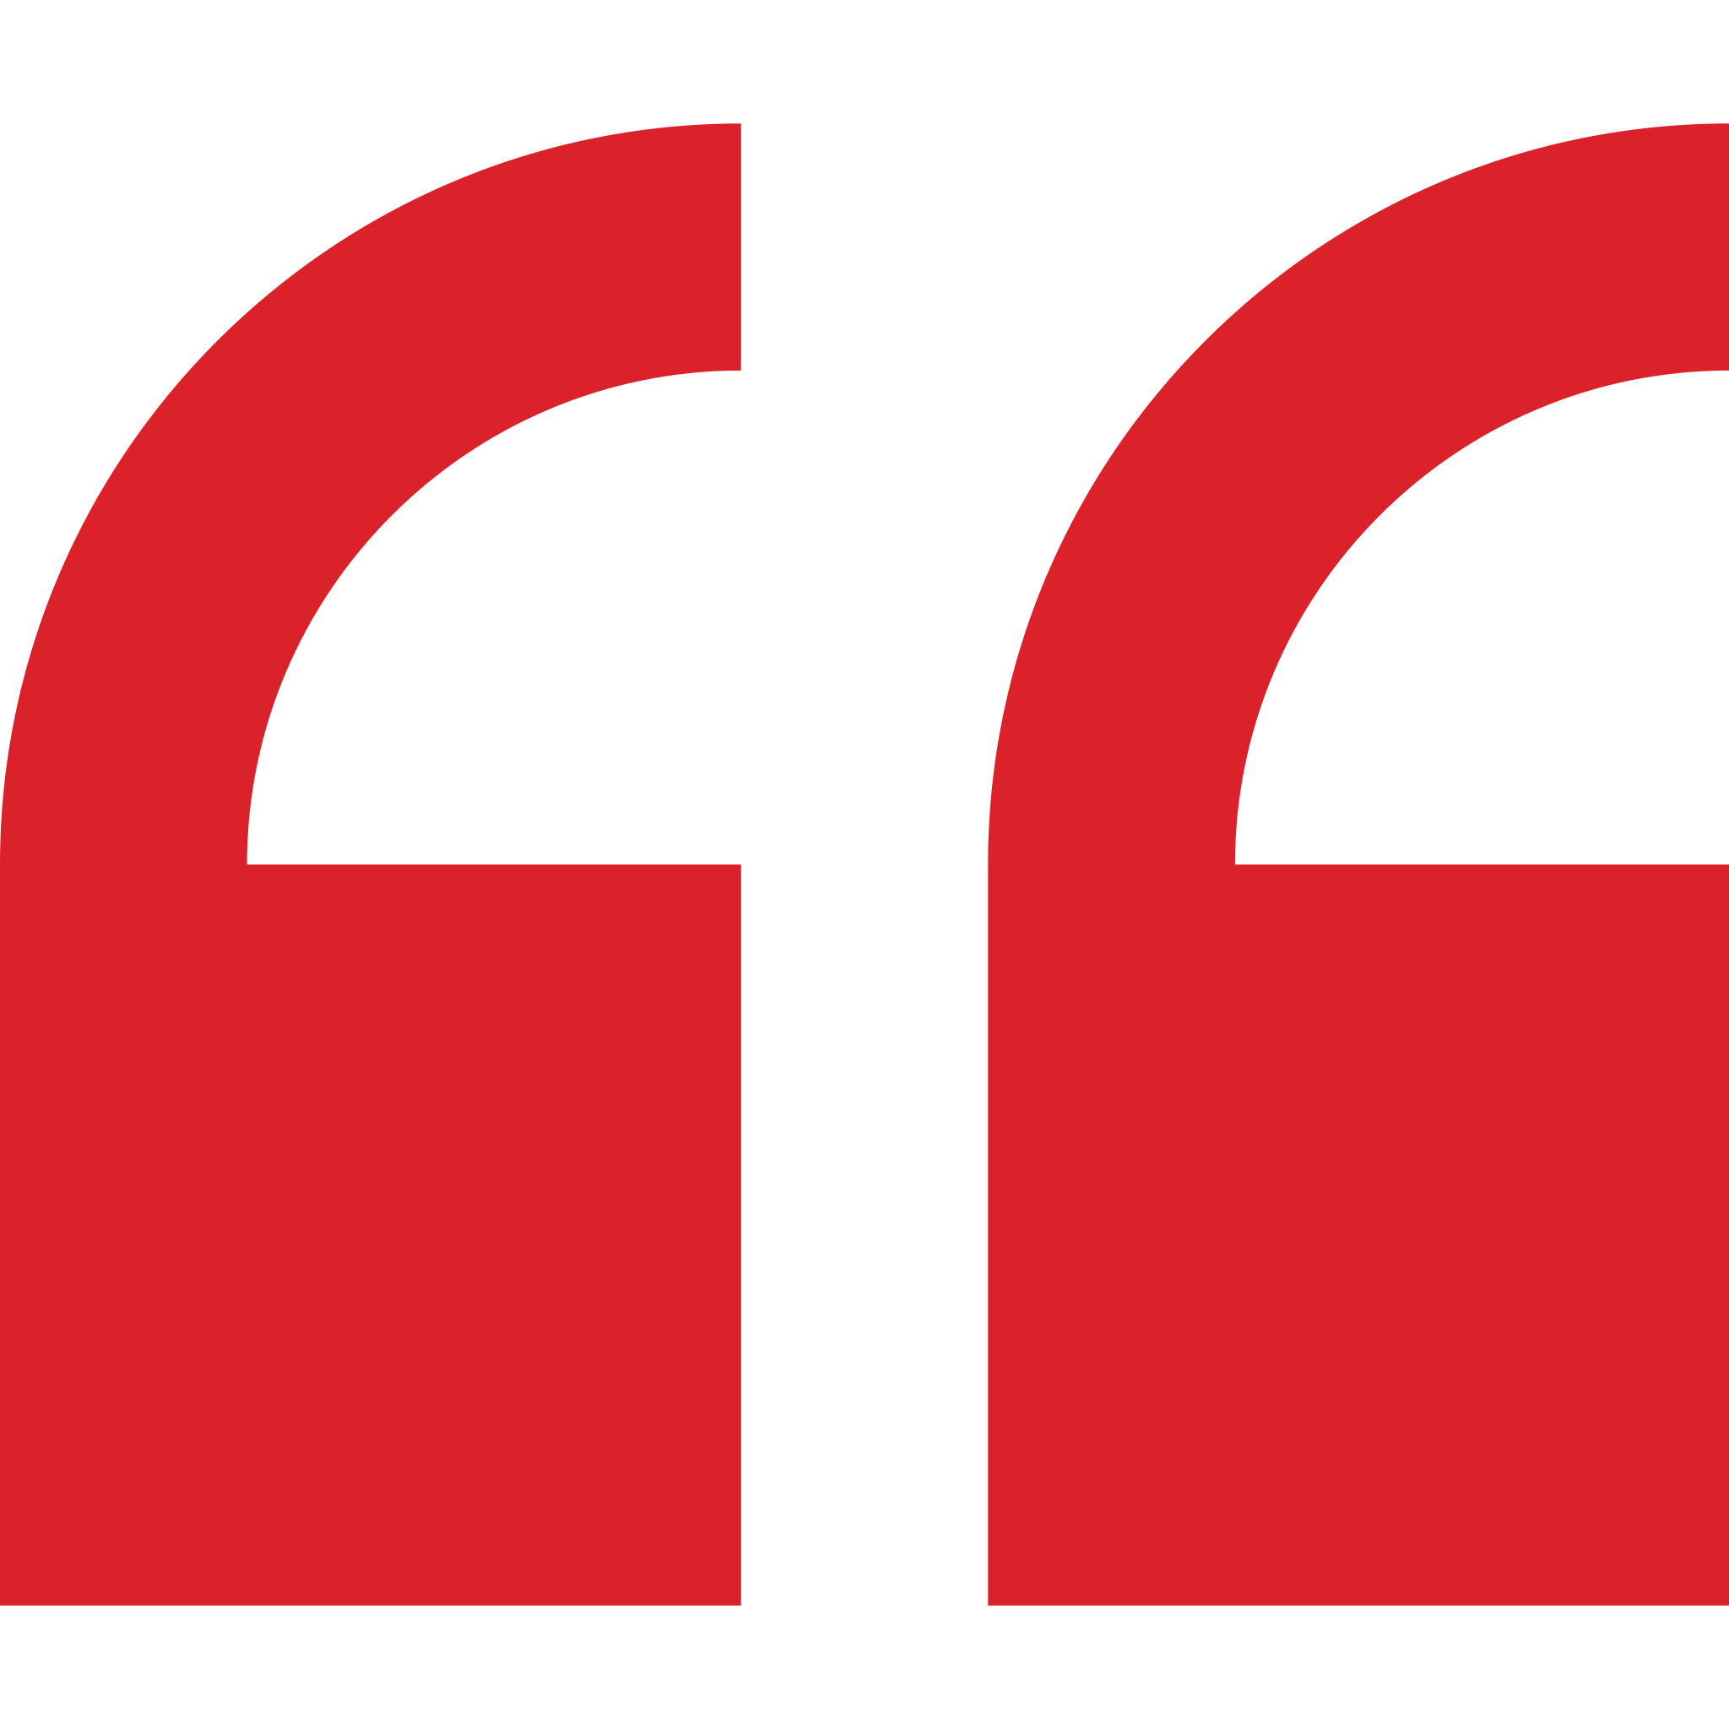
Boye Yisa – Analyst
Professional experience
Education and skills
Africa Foresight Group
Led a route-to-market transformation for an agricultural outputs company in Cote D’Ivoire
Consultant, McKinsey & Company
Co-developed a health access service delivery model for two (2) states in Nigeria to improve health outcomes over five (5) years
Developed initiatives to reduce cost and improve operations within a major multinational telecoms player; capturing ~ $1Bn in savings within five (5) years
Designed implementation road map for adopting hybrid service delivery package (SDP) of outreach based vs facilities based healthcare services
Boye holds a Bachelor Degree from Covenant University, Nigeria
Boye speaks English and Hausa fluently and has intermediate abilities in French
Introduction
Boye is a business consultant who worked at McKinsey & Company for a year before seeking a new opportunity to serve Africa.
He is extremely passionate about working in West Africa and has worked closely with public sector clients in Nigeria.
Boye is an experienced business advisor with strong communication skills and brings positive energy to the teams he works with.
I’m passionate about the development of the African continent, AGF’s belief in reshaping narratives of business in Africa and empowering local brands in becoming global champions.

